Slide 1
Protein Spectrum Quality Prediction
DS5500 Project 1
Liang Xue, Xubo Tang
05/19/2020

Slide 2
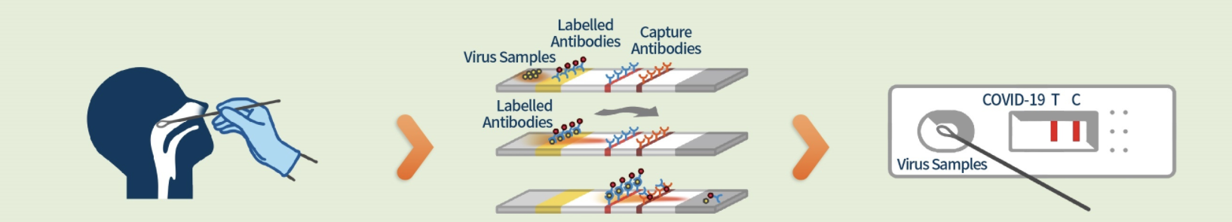
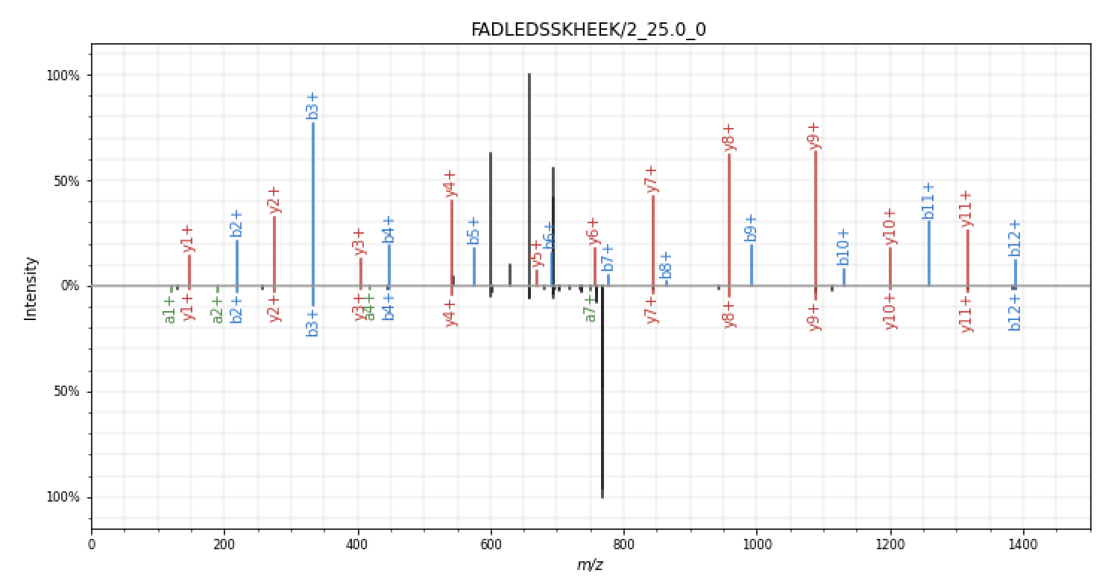
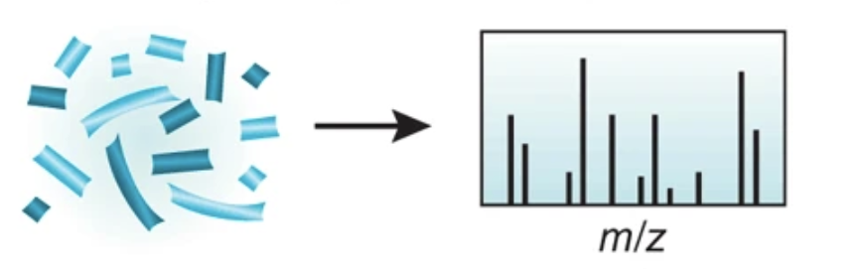
To determine the quality of protein spectrum
Mass spectrometry based spectrum is the readout of proteins
Proposal: Machine learning for fast classification
Patient
DNA
ReagentKit
Good (top) vs Bad (bottom)
Protein
Spectrum
Object
Sample
Readout
Duncan et al. The pros and cons of peptide-centric proteomics. 2010. Nature Biotechnology.

Slide 3
Workflow
hyper-parameter tuning
model evaluation
ETL
result interpretation
model fitting
spectrum readout dataframe
Encapsulation
optimal model
.exe file with GUI

Slide 4
Dataset (340k training, 85k test)
Spectra File
Label File
spectrumID | 0-10 | 10-20 | 20-30 | ... | 1990-2000 | usable
1 | 0 | 248 | 1128 | ... | 0 | True
2 | 0 | 0 | 0 | ... | 0 | False
3
4
... | ... | ... | ... | ... | ... | ...
ID | Sequence
1 | ABC
2
3
4 | DEF
5 | XYZ

Slide 5
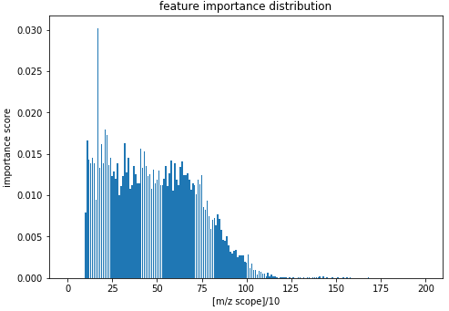
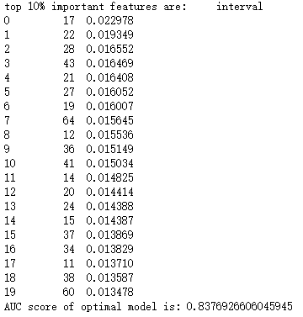
Feature selection
m/z scope: 170-180
m/z scope:0-1250
importance score measured by impurity reduction
m/z scope: 270-280
m/z scope: 410-420
…...
spectrum features (predictors)

Slide 6
Hyperparameter tuning
Different learning algorithm
SVM: 0.59
Random Forest: 0.75
MLP: 0.65
Random forest classifier fitted on quantitative features
Hyper-parameter tuned by grid search
Model evaluated by AUC score and ROC curve

Slide 7
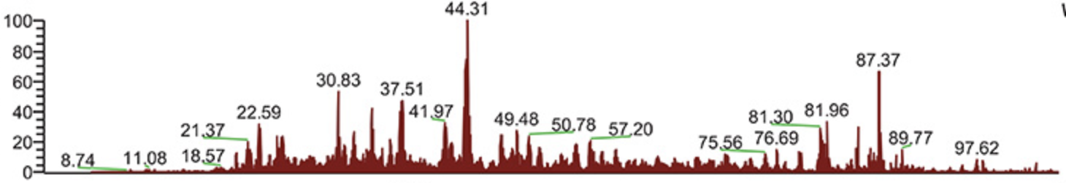
Delivery and maintenance
Graphical interface allowing user to upload the experiment, and navigate to result summary
The prediction will be executed automatically once file upload
The model could be retrained if the user provide new sets of experiment and corresponding labels
Considering the complexity, the maintenance of this product should be minimal.
Spectrum QC Tool
Upload
Predict
Result export
Train

Slide 8
Summary
Comprehend a MVP for spectrum QC prediction
Given new experiments, label each spectrum with protein exists or not
Enable the update on training dataset
Visualize the important spectrum region
Future work
Data analysis for observation
Improve data exploration

